Slide 1
Indiana Senior Medicare Patrol (SMP)

Slide 2
Today’s Focus
What is SMP?
How Medicare Fraud Impacts You and Your Loved Ones – What can YOU do?
New Medicare Cards – coming soon!
How to Read Your Medicare Summary Notice (MSN)

Slide 3
Senior Medicare Patrol (SMP)…
Is a federally funded program that exists in every state, the District of Columbia, Puerto Rico and Guam.
Relies on partners and volunteers, to educate Medicare beneficiaries, caregivers and the professionals that serve them on how to prevent, detect, and report health care fraud, error and abuse.

Slide 4
Senior Medicare Patrol (SMP)
Together with our partners and volunteers we participate in:
Outreach Events
One-on-One Counseling Sessions
Presentations
Media Outreach

Slide 5
Medicare Fraud Impacts YOU
Costs taxpayers between $60-90 BILLION per year!
Takes advantage of vulnerable people – older adults and persons with disabilities.
Threatens the integrity of the Medicare Trust Fund
Impacts a growing number of people – Roughly 10,000 people a day are turning 65 for the next 19 years!

Slide 6
What about Errors?
Health care services and billing are complicated, which can lead to errors…
and if necessary, a review and investigation of the issue will determine if it is an error… or if it is fraud or abuse.
Notes:
In addition to fraud and abuse, it’s also important to consider errors. Providing and billing for health care services involves a lot of complicated steps, which may lead to errors. Most Medicare payment errors are simply mistakes and are not the result of physicians, providers, or suppliers trying to take advantage of the Medicare system.
Sometimes what may seem like a simple error can turn out to be fraud or abuse, and what might appear to be fraud or abuse can be a simple error. Only a review and investigation of the issue will determine whether it is an error, fraud, or abuse.

Slide 7
New Medicare Cards are coming
What to Expect

Slide 8
Your New Medicare Card
Information for People With Medicare

Slide 9
Fraudsters are always looking for ways to get your Social Security Number…
New Medicare Cards
so Medicare is removing SSN from all Medicare Cards to make them safer.

Slide 10
Starting in May 2018, Medicare will mail New Medicare Cards to all people with Medicare…
New Medicare Cards
Indiana beneficiaries will begin receiving new cards sometime after June.

Slide 11
New Medicare Cards
In an effort to deter identity theft, Medicare is replacing current cards with a New Medicare Card that will include include a new unique Beneficiary ID Number.

Slide 12
What You Need to Know
All beneficiaries will receive a new card BY MAIL between April 2018 and April 2019
Make sure your mailing address is UP-TO-DATE with Social Security, 1 (800) 772-1213
Once new card is received, SHRED YOUR OLD CARD
There is NO CHARGE for new card

Slide 13
What You Need to Know
The new card has NO IMPACT ON BENEFITS/COVERAGE
No action required on your part – and Medicare will never ask you to give personal or private information to get your new card
You may want to sign up for an email alert to know when the card is being mailed to you: https://www.medicare.gov/newcard/

Slide 14
New Medicare Card Scams
Scammers may pose as Medicare reps and claim they need to confirm your old number before mailing the new card.
Medicare won’t usually call you! There are only a few times Medicare may call you:
A Medicare health or drug plan can call you if you’re already a member of the plan. The agent who helped you join can also call you.
A customer service representative from 1-800-MEDICARE can return your call if you’ve called and left a message or a representative said that someone would call you back.

Slide 15
New Medicare Card Scams
Watch Out for anyone who…
Asks you to confirm your Medicare or Social Security Number so they can send you a new card.
Asks you to verify your personal information and provide credit card info in order to pay for your new card.
Threatens to cancel your health benefits if you don’t share your Medicare Number or other personal information.
Pressures you in any way to provide information.

Slide 16
How You Can Protect Yourself
Create an account on MyMedicare.gov
Read your Medicare Summary Notices (MSNs)
Pay Attention to messages from Medicare – as seen on the news or received in the mail
Call SHIP, State Health Insurance Assistance Program (SHIP) at 1-800-452-4800
Contact your Indiana SMP Office or Area Agency on Aging (AAA) if you have questions about potential fraud or scams
If you have questions, call 1-800-MEDICARE

Slide 17
Protect Your Medicare Card
Continue to Guard Your Card…
Even though your new Medicare Card will no longer include your Social Security Number, it will include a new Beneficiary Number that is unique to you.
Scammers and Fraudsters are still able to use this number for Medical Identity Theft.

Slide 18
Get to Know Your Medicare Summary Notice (MSN)
Mailed to you quarterly
To access info more frequently, call 1-800-MEDICARE or
create an account on MyMedicare.gov – request monthly eMSN
Informs you of what has been billed to Medicare in your name
Medical services and/or supplies
Doctor/hospital visits
Durable Medical Equipment (DME)
Procedures, tests, etc.
Provides explanation and instruction
Payments paid by Medicare on your behalf
Amounts to be paid by you (or other insurance plan if you have one)
Claims appeal process

Slide 19
Just the Basics
Are your name and address correct?
Verify your deductible status
Review your claims and cost
Are your providers, appointments, and services reflected accurately?

Slide 20
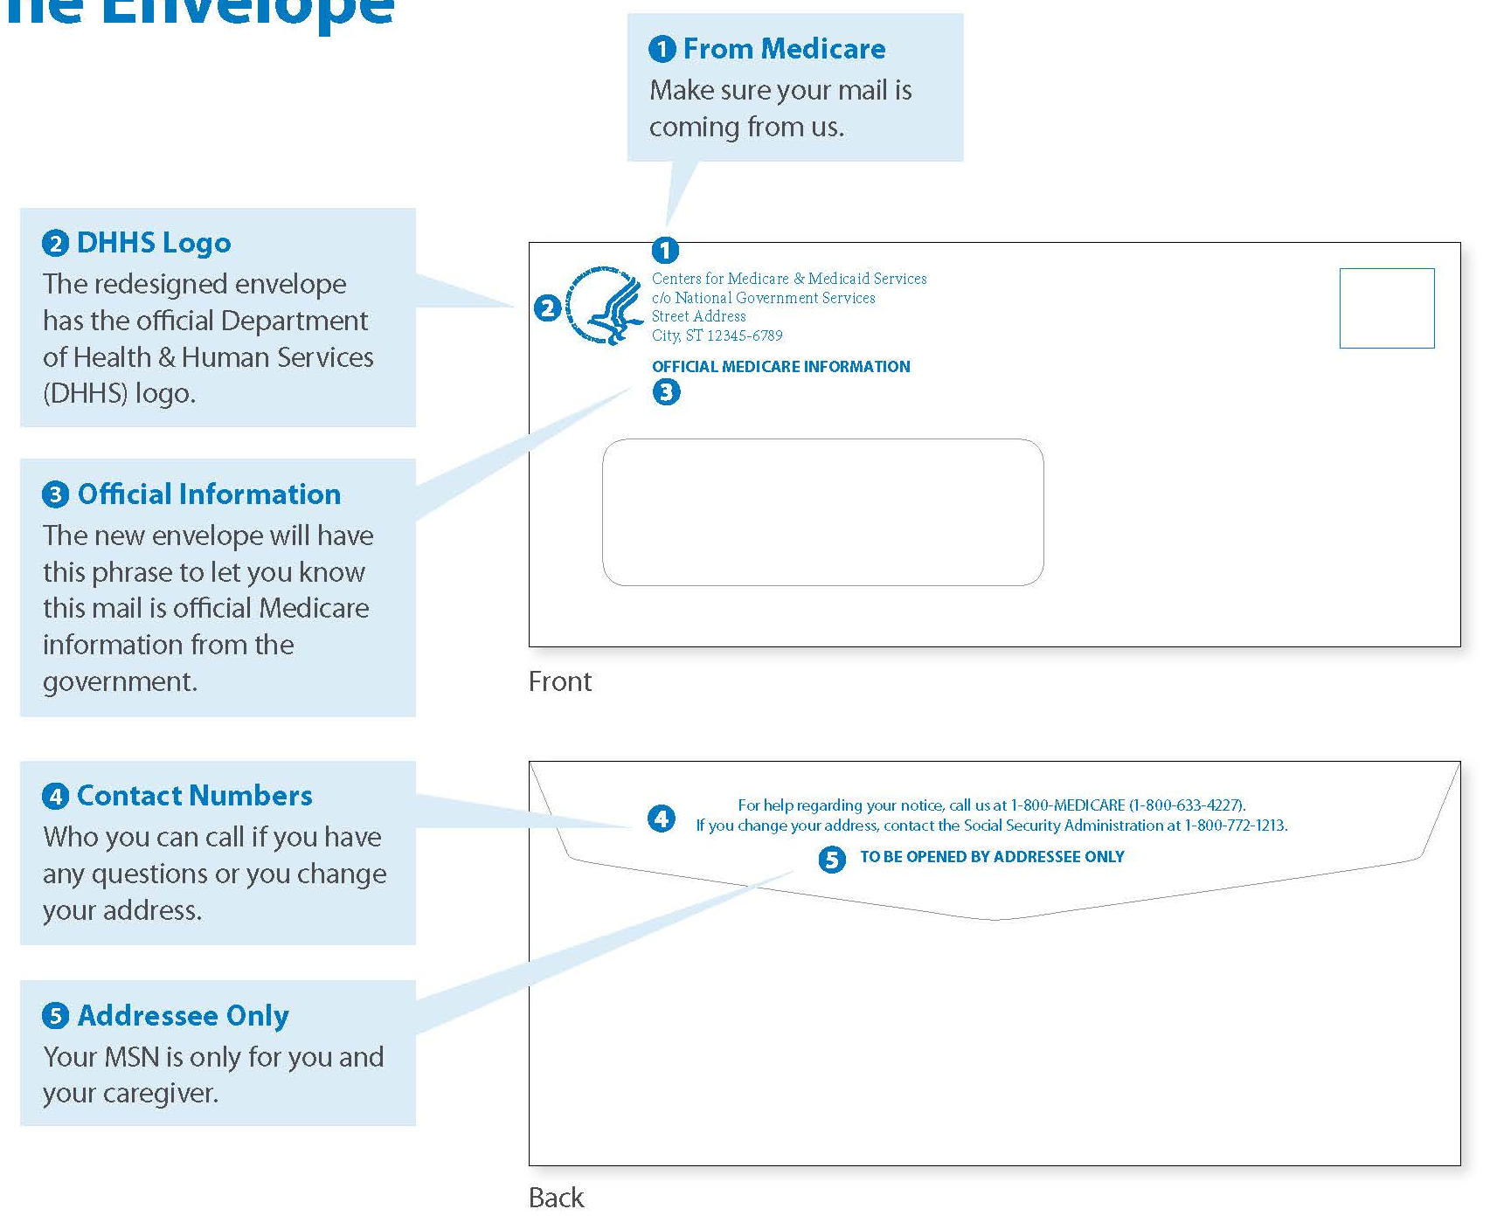
MSN Envelope

Slide 21
Page 1 – Your Dashboard

Slide 22
Page 2 – Making the Most of Your Medicare

Slide 23
Page 3 – Your Part B Medical Claims

Slide 24
Page 4 – How to Handle Denied Claims

Slide 25
Questions About
Your MSN?

Slide 26
Call Indiana SMP at 317.205.9201
Nancy Moore – Indiana SMP Director
nmoore@iaaaa.org
Mary Wallace – Volunteer and Training Coordinator
mwallace@iaaaa.org
Barb Miller – Outreach Coordinator
bmiller@iaaaa.org
OR
www.iaaaa.org/smp.asp
www.facebook.com/INSMP
1-800-986-3505

Slide 27
Thank You!

